Slide 1


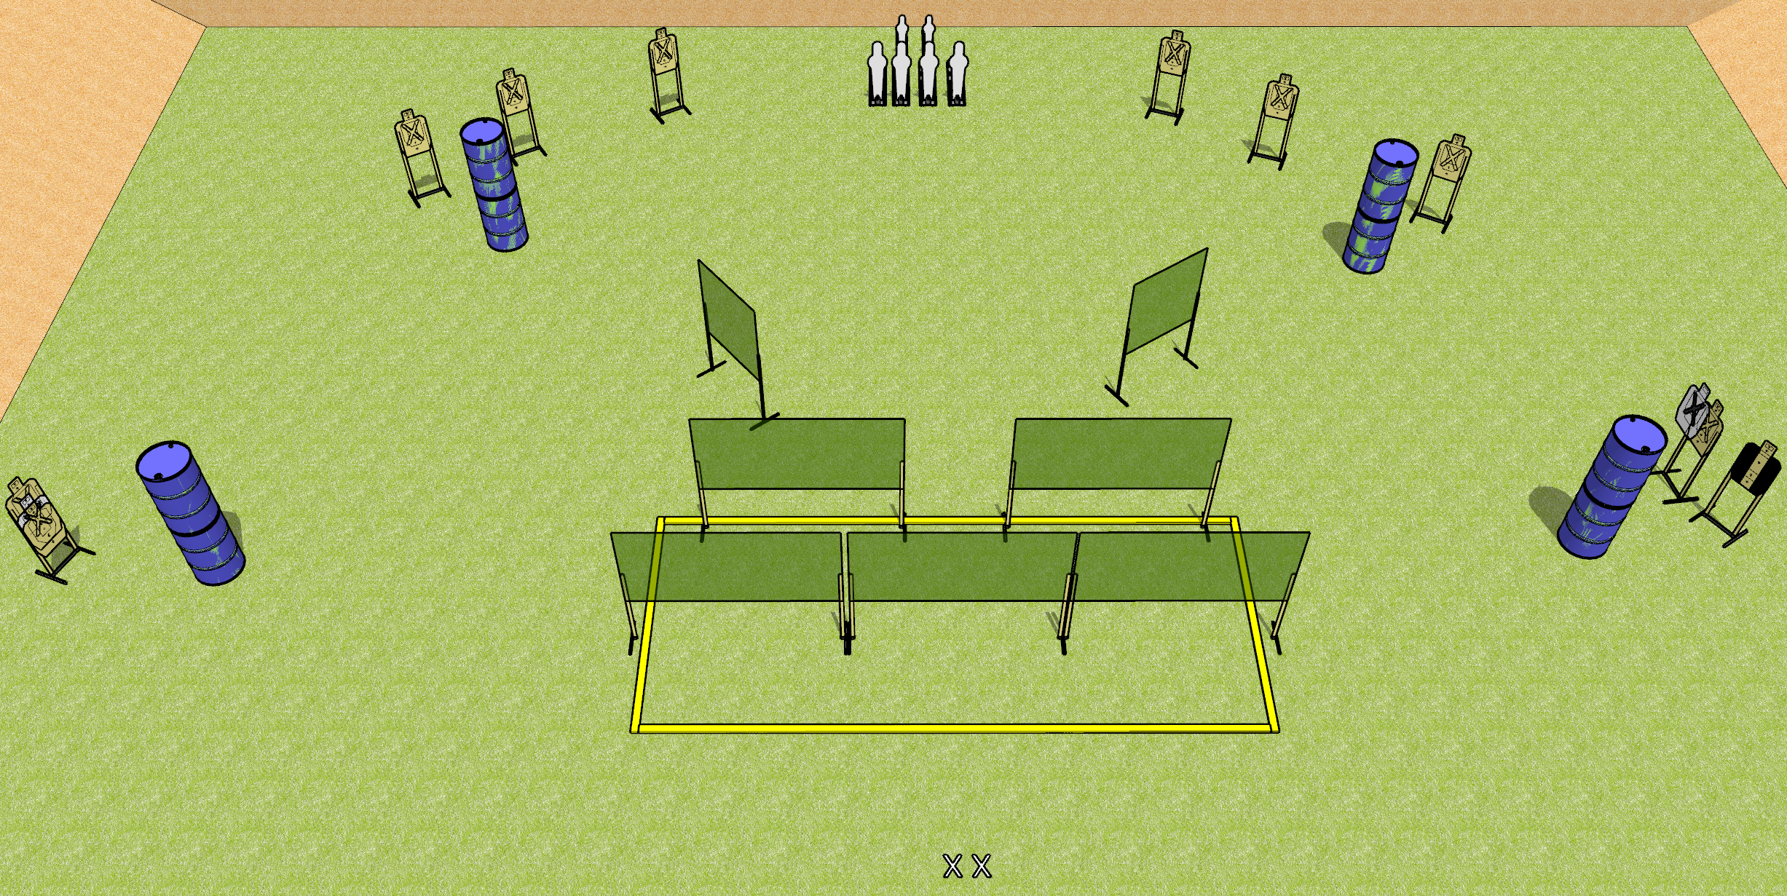
 | Dothan Gun Club – USPSA Match The Great Wall Course Designer : Drew Coleman
START POSITION : Standing with both feet on X’s. Hands relaxed at sides.
GUN READY CONDITION : Pistol loaded and holstered. PCC shouldered, safety on, pointed at center wall in shooting area. |  | SCORING: Comstock, 26 rounds TARGETS: 10 paper, 6 Steel SCORED HITS: Best 2 on paper, steel until down START-STOP: Audible, last shot RULES:
STAGE PROCEDURE: Engage targets as they become available from within the fault lines

